Slide 1

Backplane Buses
Bus Standards
Backplane Interfacing
  Bus Drivers and Receivers
  Noise Immunity
  Bus Contention
  Backplane Buffering: Tri-State and Open Collector/Drain
©Paul Davies. Not to be copied, used, or revised without explicit written permission from the copyright owner.
This lecture may contain animations and is best viewed as a slide show

Slide 2
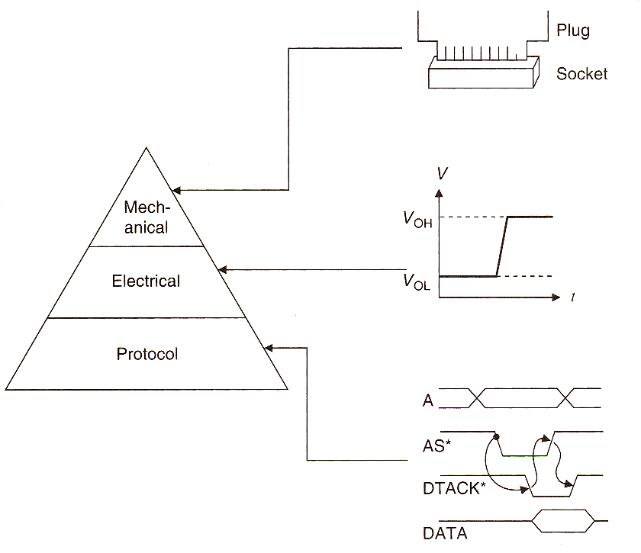
Backplane Buses: Factors Affecting Choice
What Defines a Bus Standard?
All good internationally standardised backplane buses define a specification for the following
bus characteristics:-
  Mechanical
  Electrical
  Protocol
What are the Issues Affecting Bus Choice?
Cost – Affected by size of backplane, choice of connector and number of PCB layers, data and address bus width.
Speed - The longer the backplane/more modules that can be plugged in, the slower the speed due to end-to-end propagation delays and capacitive loading. Protocol affects speed (asynchronous vs. synchronous) and type of signaling e.g. ground referenced vs. differential.
Compatibility - Make sure the Mech, Elec and Protocol standards are sufficiently well specified to allow compatibility between vendors.

Slide 3
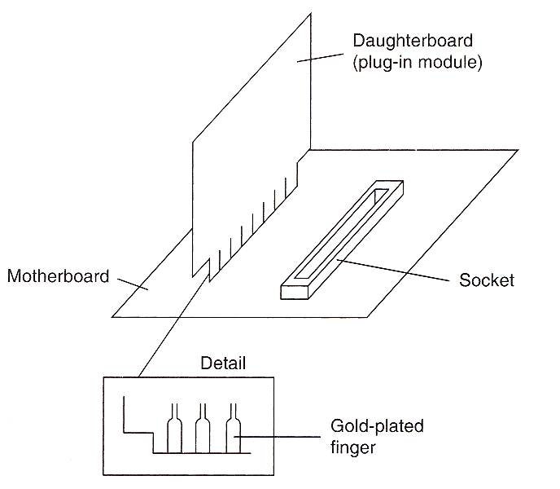
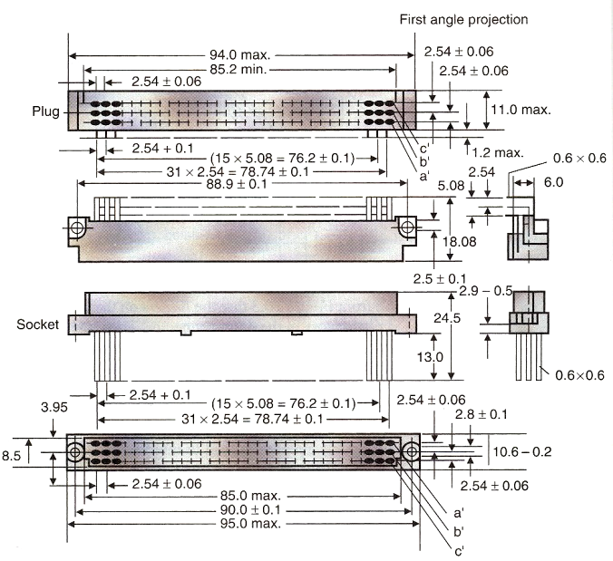
Backplane Buses: Mechanical Specification
Mechanical Specification
The Mechanical Specification of a bus describes such things as :-
  Physical Dimensions of the cards, backplanes and backplane sockets, pin spacing, spacing between cards, number of slots etc.
  Fixings, alignments and mountings – how is the backplane fixed inside a rack. How do cards ‘make electrical connection’ with the backplane. What prevents cards from shaking loose?
  Polarisation – What physically prevents you plugging a card in the wrong way around?
  Heat dissipation and component layout – suggestions regarding cooling fans, maximum wattage per board.
  Power connections – type, dimensions, fixings etc.
  Type of Backplane Connectors -
    Old fashioned gold plated ‘finger’ connectors etched on to the PCB are cheap but unreliable if the module is inserted/removed frequently. Their use is limited these days to daughter boards and memory modules with infrequent removal.
    The international DIN 41612 connector is very reliable offering a virtually gas-tight seal and offers polarisation protection, but is expensive. Half the socket is on the backplane, half on the module.
The cost of the bus to the user is mostly influenced by the mechanical spec of the backplane and connectors.
The speed/performance of the bus is much more likely to be affected by the electrical and protocol issues.

Slide 4
Backplane Buses: Electrical and Protocols Specifications
Electrical Specification
This defines such things as
  Clock Frequencies.
  Pin assignment on connectors.
  Voltage Levels.
  Signalling Technology :
    CMOS,
    Bipolar (TTL),
    Differential signalling (LVDS) etc.
  Backplane signal layout suggestions –
    Use of multilayer PCBs,
    Ground planes
    Suggestions for minimum track width, size and spacing.
  Maximum capacitive and inductive loading of a module plugged into the backplane.
  Bus termination techniques.

Slide 5
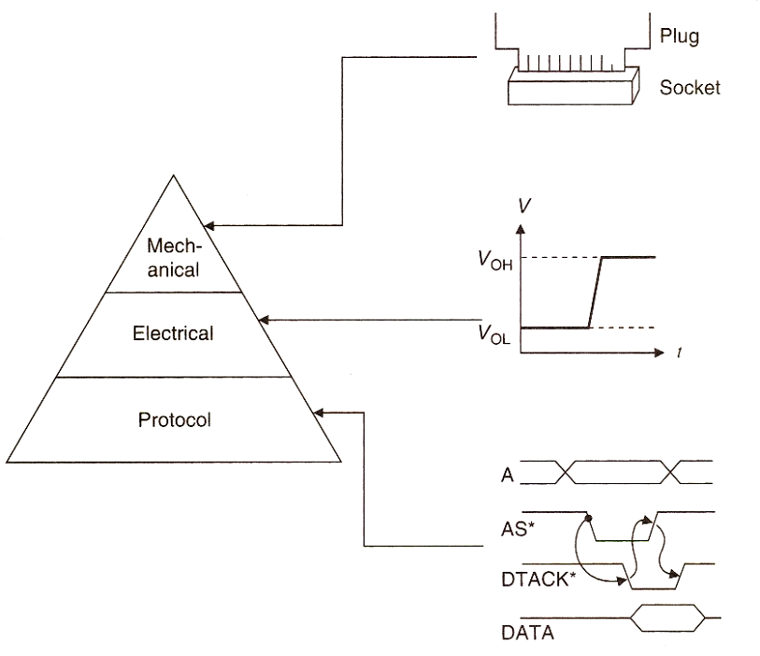
Backplane Buses: Electrical and Protocols Specifications
Protocol Specifications
The Protocol defines the various timing diagrams and signaling/handshaking requirements related to the operation(s) of the bus, for example it defines the timing and protocol of
  Data exchange over the bus. (DTACK*, Wait States etc.)
  IRQs (prioritised levels, acknowledge etc.)
  Bus arbitration policies particularly in multi-processors systems (BR*, BG*, BGACK* etc.)

Slide 6
Backplane Interfacing

Slide 7
Backplane Buses: Bus Drivers
Interfacing Modules to a Backplane Bus
As a microcomputer system designer, perhaps the most important aspect of our work concerns the proper and correct functioning of the backplane bus under all electrical loads.
When we start to modularise our computer via an arrangement of plug in boards we have to give some thought to the electrical interface between the boards themselves and the backplane which carries the signals between boards.
Connecting the CPU signals directly onto the backplane and from there directly to every chip on every plug-in module in the system would simply overload the current capabilities of the CPU signals due to high current and capacitive loading which would lead to very slow rise/fall times.
Bus Drivers (Bus Buffers)
Bus drivers (or bus buffers) isolate the electrical and capacitive loads of the chips connected to a backplane signal from the driver of that signal.
Ideally, a bus driver should have drive and load characteristics closely matched to the task of driving a particular backplane signal.

Slide 8
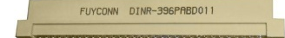

Backplane Buses: Bus Drivers
A bus driver is an ‘active’ device employed to physically alter the voltage of signals on the bus. In other words it drives the signal to a logic 1 or 0.
The driver might use single-ended (ground referenced) voltages e.g. CMOS or TTL or differential signaling such as LVDS (low voltage differential signaling) as used in say PCi-Express (as well as Ethernet, USB and other network buses)
Other modules on the bus, use bus receivers to buffer the signal locally and isolate the loads of that module from the bus driver.
1 Ground Referenced Backplane Signal: Repeat for all other signals
Bus Receivers
Bus Driver
CPU Address Line
Address Line
Address Line
CPU Card
Peripheral Module
Memory Module

Slide 9
Backplane Bus Drivers: Idealised Characteristics
Idealized Bus Driver Characteristics
Offer minimal propagation delay.
It should have good electrical noise immunity
Have the ability to sink/source sufficient current to drive the bus in the presence of the large electrical and capacitive loads presented by the many plug in modules and the backplane itself. That is, a low output impedance.
Be able to disconnect itself from the bus (where necessary) to avoid contention, i.e. disable itself, so that other modules can drive the bus (tri-state), particularly in a CPU backplane, where only one CPU can drive the bus at any instance.
For example a CPU module must be able to disconnect itself from driving say the data bus when that bus signal needs to be driven by a memory module supplying data during a read cycle, i.e. you do not want the memory module bus buffers and the CPU bus buffers conflicting.

Slide 10
Backplane Buses: Bus Receivers
A bus receiver is a passive device that detects 0 or 1 on the signal. It is used by plug-in modules to decouple the backplane signal locally.
Idealized Bus Receiver Characteristics
Ideally a bus receiver should offer:-
  Minimal propagation delays.
  High Electrical DC noise immunity (like the driver).
  Minimal electrical and capacitive loading of the bus. (Ideally Infinite Input Impedance, Zero Capacitance and Inductance loading).
  High current drive capability and low output resistance
1 Backplane Bus Signal repeat for all signals
Receivers
Local Bus Signal
Local Bus Receiver
CPU Address Line
Address Line
Address Line
CPU Card
Peripheral Module
Memory Module

Slide 11
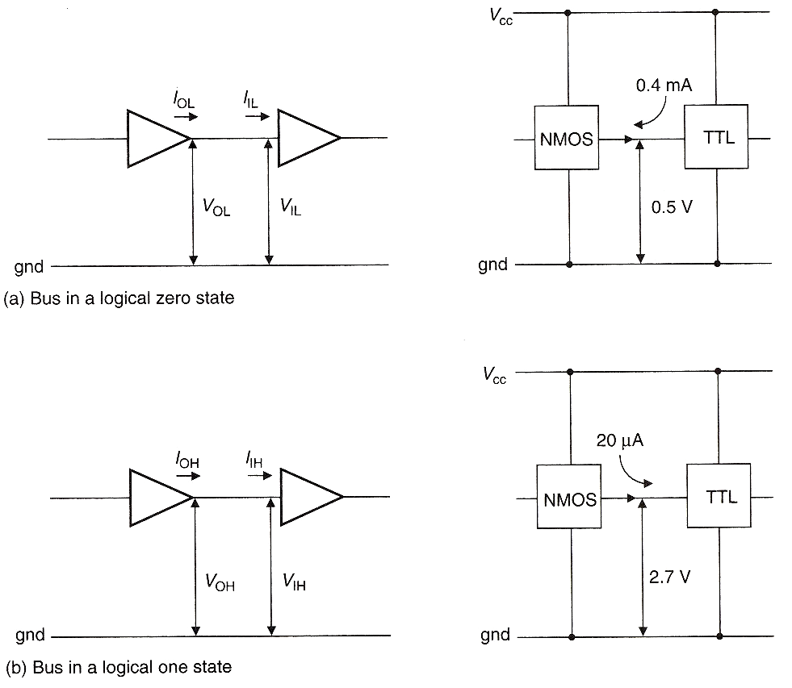
Backplane Buses: Noise Immunity
DC Noise Immunity of Bus Receivers and Drivers in Ground Referenced Signals
Noise immunity is a measure of the bus driver’s ability to tolerate electrical noise and is measured for both the logic 0 and logic 1 levels, (ultimately the lower of these two values actually defines what noise is tolerable.)
Logic 0 DC Noise Immunity is defined as V_{IL} – V_{OL}
V_{IL} is defined as the max input voltage of a receiver guaranteed to be recognised as a logic 0. Exceed this voltage and your ‘0’ risks being recognised as a ‘1’.
V_{OL} is defined as the maximum output voltage of a driver for a logic 0 signal
This gives a logic 0 noise immunity figure of 0.4 v for TTL and 1.6v for CMOS.
Bus Signal
Bus Signal
Driver
Driver
Receiver
Receiver
V_{OL} = 0.4v
(max)
V_{IL} = 0.8v
(max)
V_{OL} = 0.4v
(max)
V_{IL} = 2.0v
(max)
Logic 0 DC Noise Immunity for
TTL = 0.4v (V_{IL} – V_{OL})
Logic 0 DC Noise Immunity for
CMOS = 1.6v (V_{IL} – V_{OL})

Slide 12
Backplane Buses: Noise Immunity
Logic 1 DC Noise Immunity is defined as V_{OH} - V_{IH}
V_{OH} is defined as the minimum output voltage generated for a logic 1
V_{IH} is defined as the minimum input voltage for a logic 1
This gives a logic 1 noise immunity figure of 0.4 v for TTL and 1.5v for CMOS.
V_{OH} = 2.8v
(min)
V_{IH} = 2.4v
(min)
V_{OH} = 4.5v
(min)
V_{IH} = 3.0v
(min)
Logic 1 DC Noise Immunity for
TTL = 0.4v (V_{OH} – V_{IH})
Logic 1 DC Noise Immunity for
CMOS = 1.5v (V_{OH} – V_{IH})

Slide 13
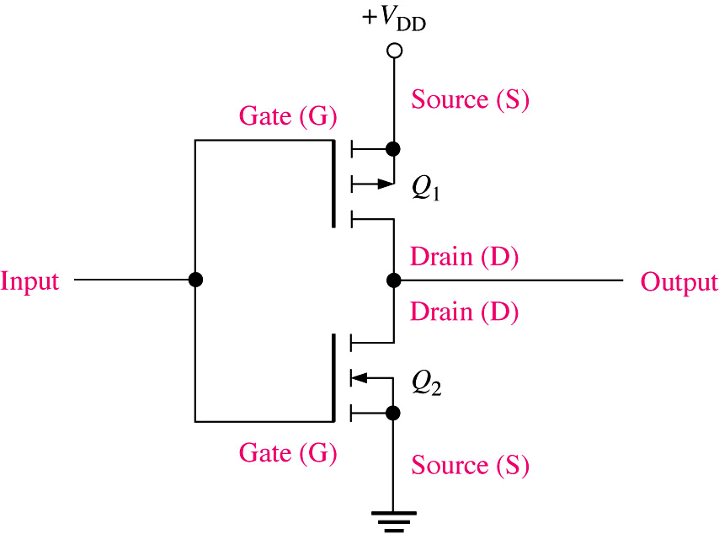
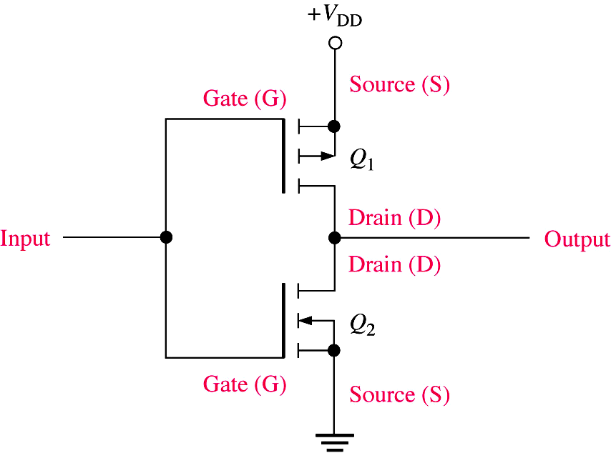
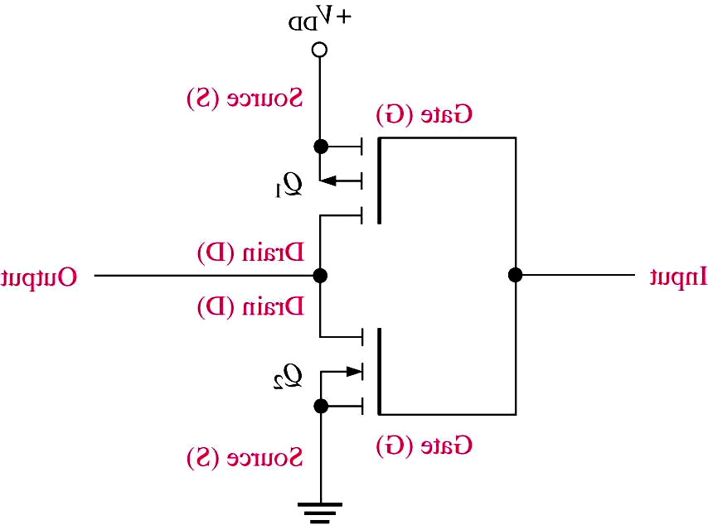
Backplane Buses: Bus Contention
Bus Contention
Bus contention occurs when two bus drivers “drive” the same signal at the same time (perhaps due to timing overlap) and must be avoided at all costs.
The circuit diagram shown here demonstrates what happens if the output stages of two CMOS bus buffers were to attempt to drive the bus signal at the same time and to opposite levels.
A large current flows from V_{DD} to ground and one or both devices blow up !!!
Q₁ On
Q₁ Off
‘P’ Channel Mosfets
(On when gate = 0)
Large Current
Logic 0
Logic 1
Bus Signal
‘N’ Channel Mosfets
(On when gate = 1)
Q₂ Off
Q₂ On
Bus Driver 1 Inverting Output Stage
Bus Driver 2 Inverting Output Stage

Slide 14
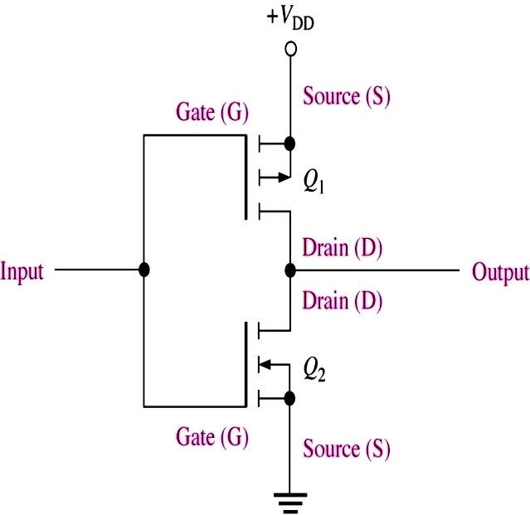
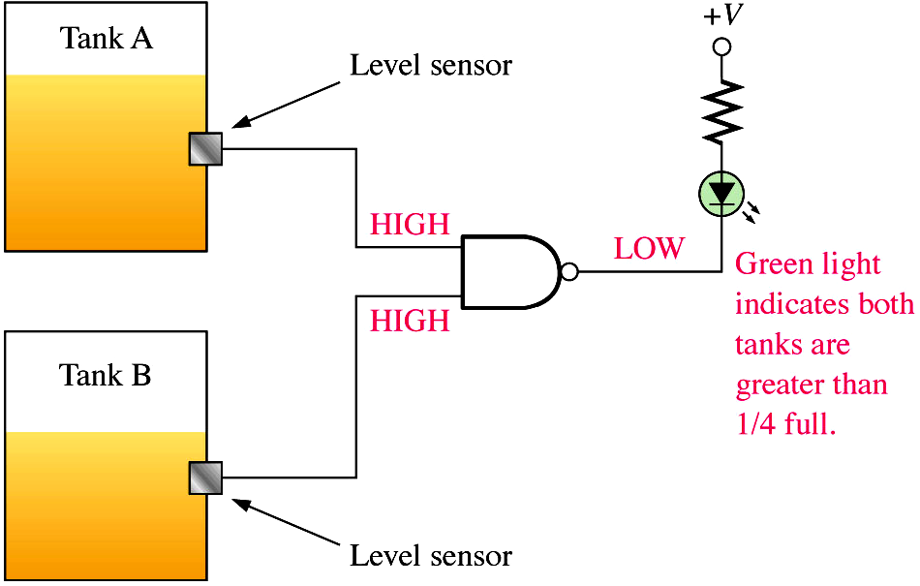
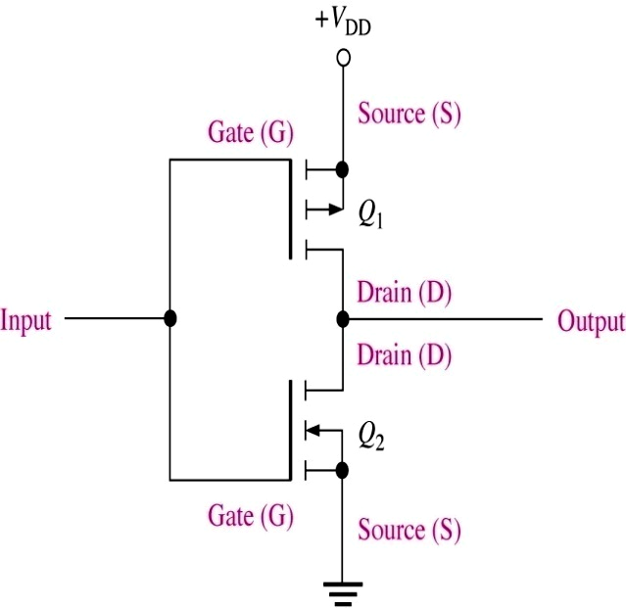
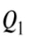
Backplane Buses: Open Drain Technology
Avoiding Bus Contention
One solution is to use Open Drain (CMOS) or Open Collector (TTL) technology
Here the upper Q1 mosfet of a conventional driver has been eliminated so that the drain of the lower Q2 mosfet is left floating.
This means Q2 can only drive the signal to a logic 0 when conducting.
A logic 1 is generated by a ‘pull-up’ resistor, which ties the bus signal to ‘1’ ut only if all Q2’s are turned off.
Q2 can “pull down” the signal and thus a 0 takes precedence over a logic 1.
Nothing is blown up, since the pull up resistor limits the current flow.
Technique is commonly used with IRQ’s and with IIC bus signals.
Pull Up Resistor able to assert a logic 1 only when no bus drivers are asserting a logic 0
Open Drain connection, Q2 can only pull down, not up
Logic 0
Logic 1
Bus Signal
‘N’ Channel Mosfets
(On when gate = 1)
‘N’ Channel Mosfets
(On when gate = 1)
Q₂ Off
Q₂ On
Bus Driver 1
Bus Driver 2

Slide 15
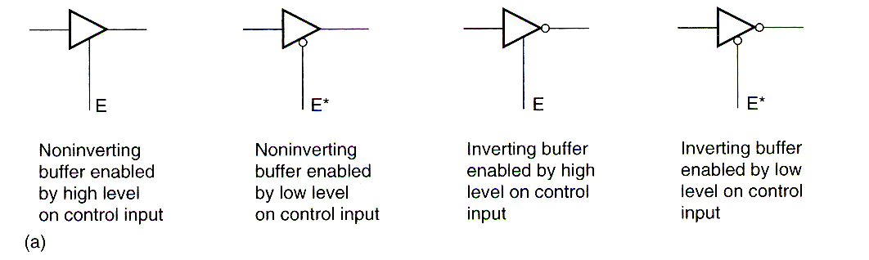
Backplane Buses: Tri-State Technology
Another solution to bus contention is to make use of a tri-state bus driver.
Such devices have the ability, via a 3rd electrical signal, to electrically isolate or disconnect themselves from the bus so that their output is effectively left floating or in a high impedance state. In effect both transistors in the output stage are turned off so that no current flows in any direction
This allows several buffers to be connected to a bus signal in parallel, provided only one of them is active (i.e. the remainder are high impedance ‘Z’)
The symbol for a tri-state gate is shown below. Some are inverting and may have either active high or active low enable signals for the tri-state control.

Slide 16
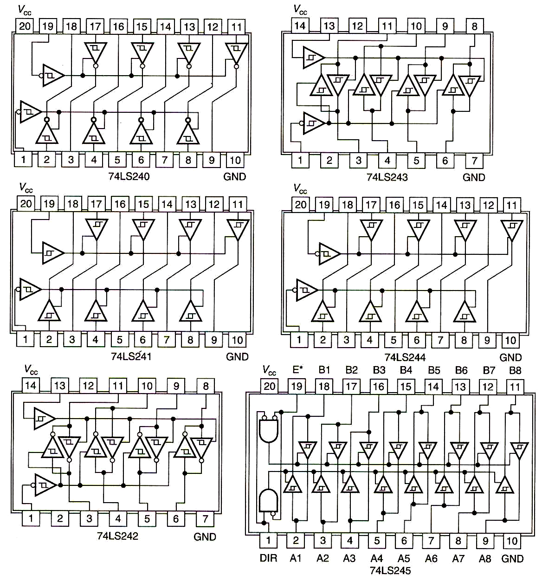
Backplane Buses: Tri-State Technology
TTL compatible Tri-State buffers (similar buffers exists for CMOS voltages) for use with ground referenced signals on backplanes
Dual 4 bit Tri-state Inverting buffer
4 bit Bi-directional non-inverting Tri-state buffer
Dual 4 bit Tri-state non-Inverting buffer
Dual 4 bit Tri-state non-inverting buffer
4 bit Bi-directional inverting Tri-state buffer
8 bit Bi-directional Non-inverting Tri-state buffer

Slide 17
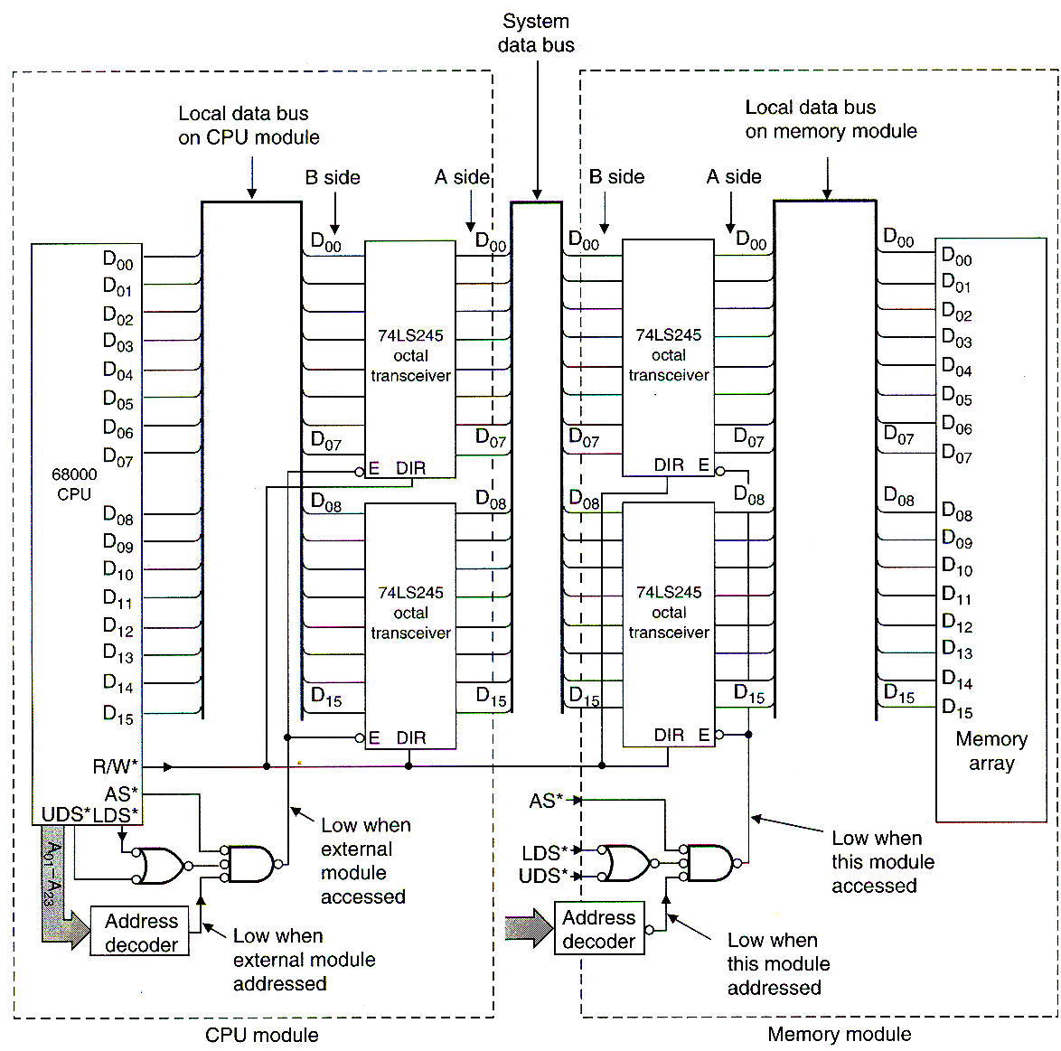
Backplane Bus Buffering
Examples – Buffering the Data bus
An important aspect here is avoiding bus contention by only enabling one driver of the bus at a time. In the example below, the CPU drives the bus only during a write.
The memory only drives the bus during a read

Slide 18
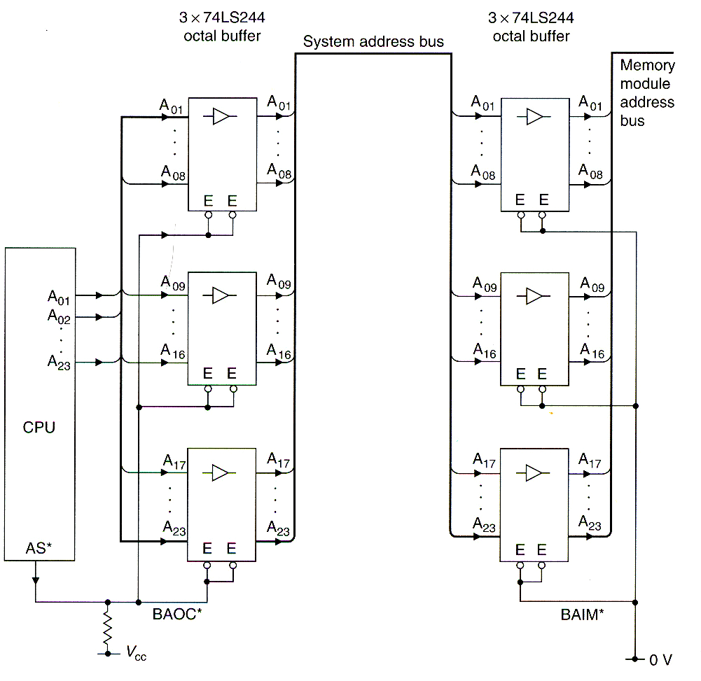
Backplane Bus Buffering
Examples – Buffering the Address and Control bus
The Address and control buses (e.g. AS, R/W, UDS, LDS etc) may need to have tri-state outputs to cope with situation where a DMA devices wished to take control of the bus and the processor may have to “disconnect” itself electrically from the bus.
Address Buffers Enabled when CPU issues an Address

